Slide 1
What is Manufacturing?
By: Nathan Harris

Slide 2
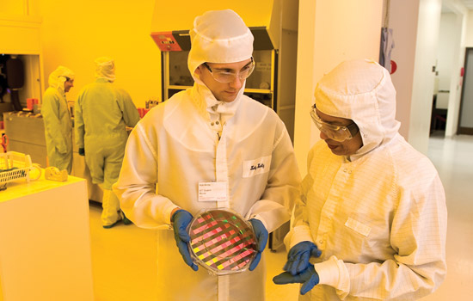
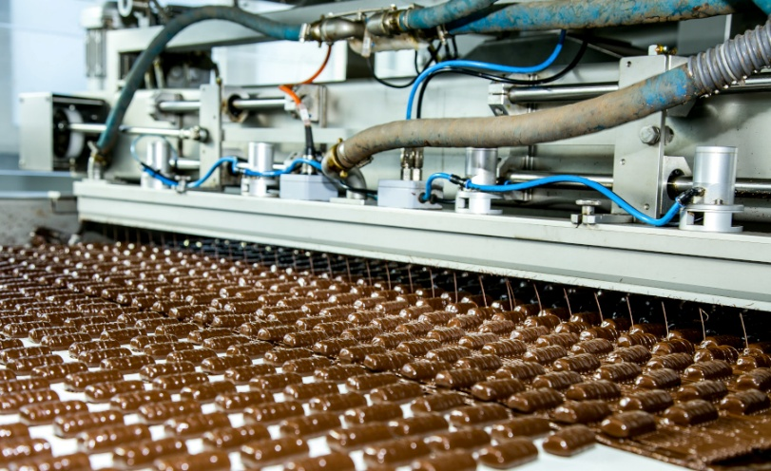
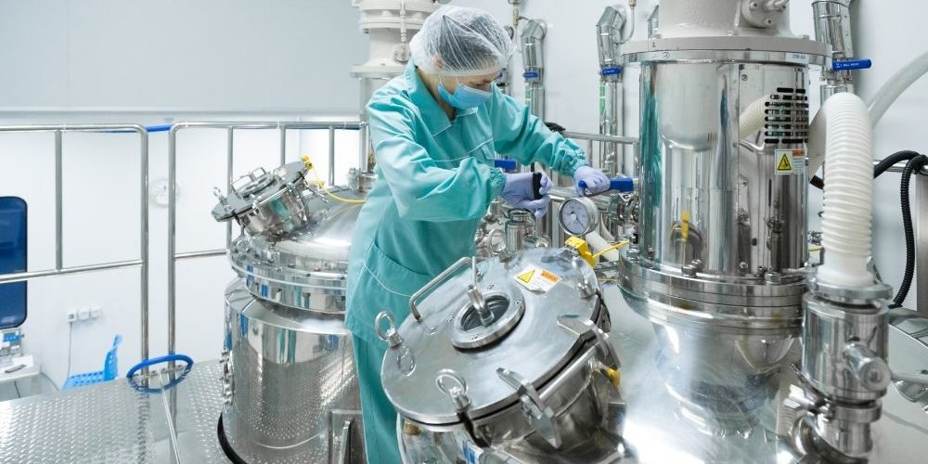
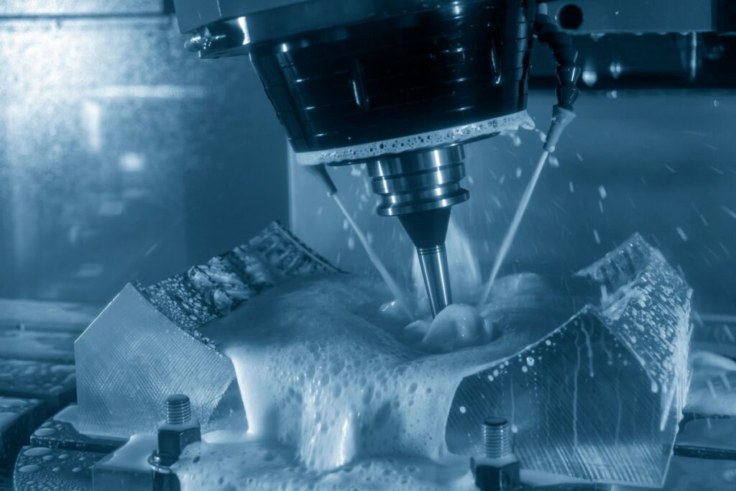
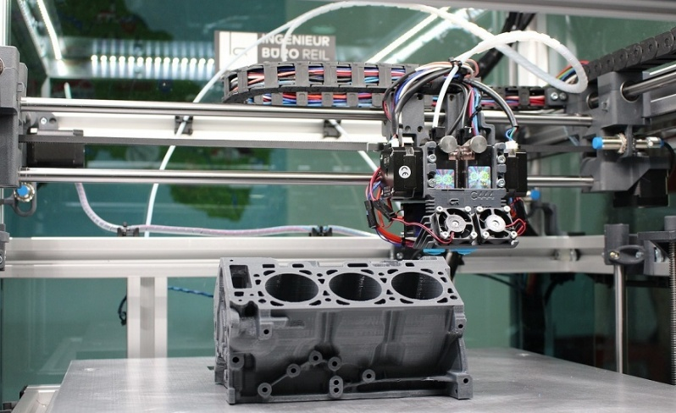
What is Manufacturing?
The process of taking a design or idea and physically implementing it.
Electrical components, integrated circuits fabrication, chemicals, foods, etc.
Solid models use many methods, but we focus on additive manufacturing.

Slide 3
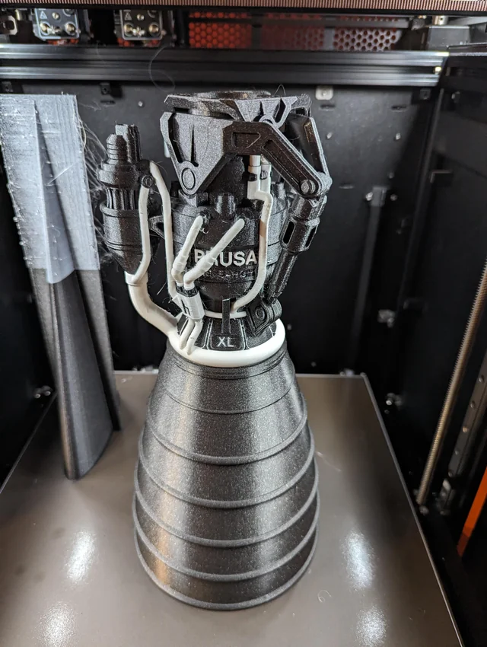
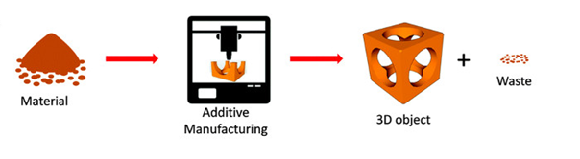
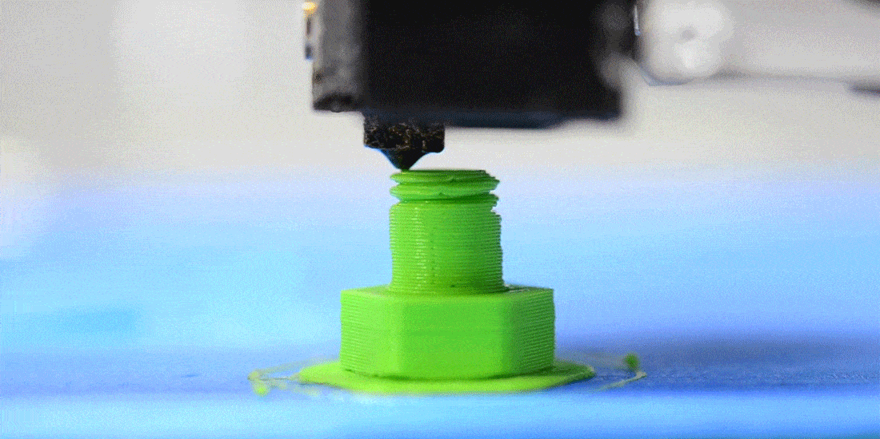
What is Additive Manufacturing?
Raw material called filament is melted by the hotend and sticks to a surface called the bed.
Both the bed and hotend can move allowing to “draw” a design.
The solid is spilt vertical into multiple “drawings” on different heights called layers.

Slide 4
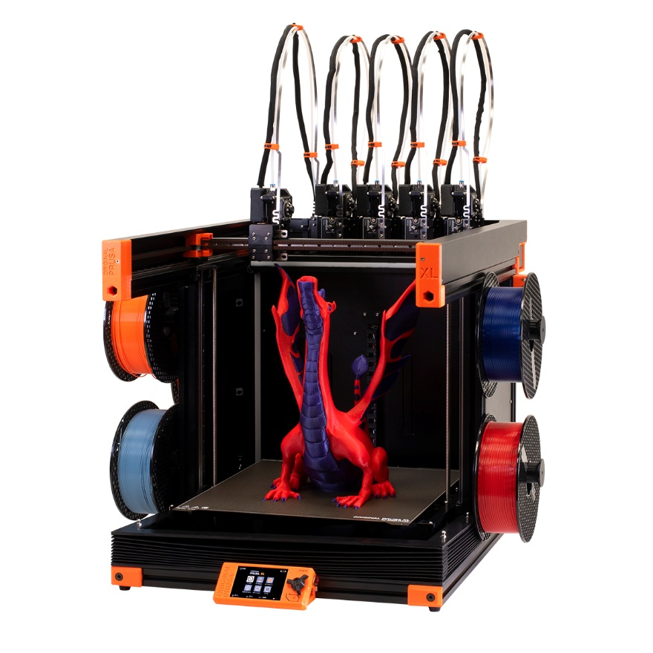
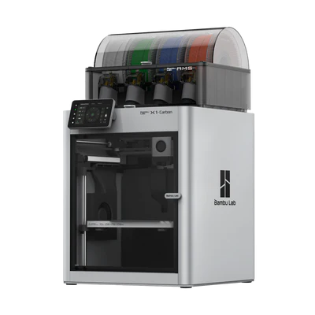
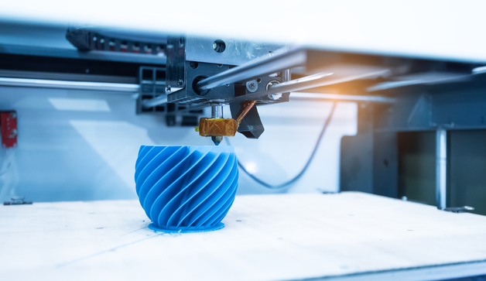
Machines Come in All Sizes
3D printers have all kinds of features like bed size, bed heating, bed auto detect, filament detection, multi color and more!
Each printer works a little differently and needs to be calibrated.
Although 3D printers can have a lot of features there is also limitations

Slide 5
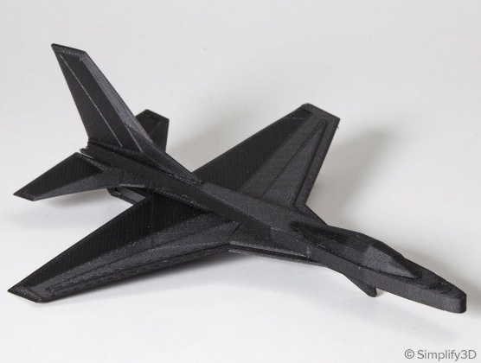
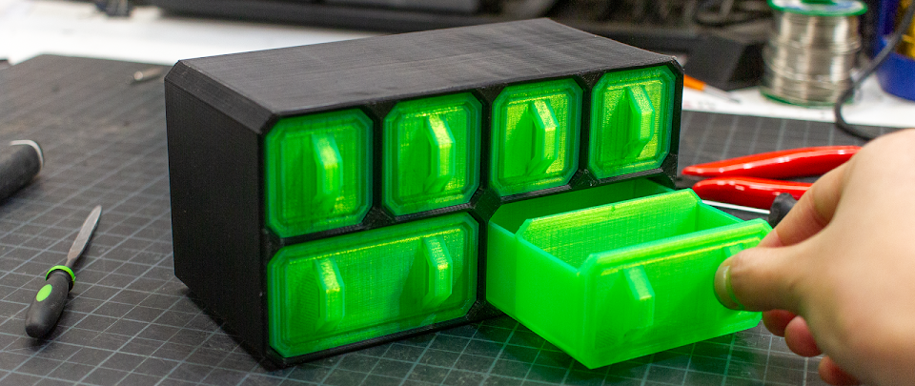
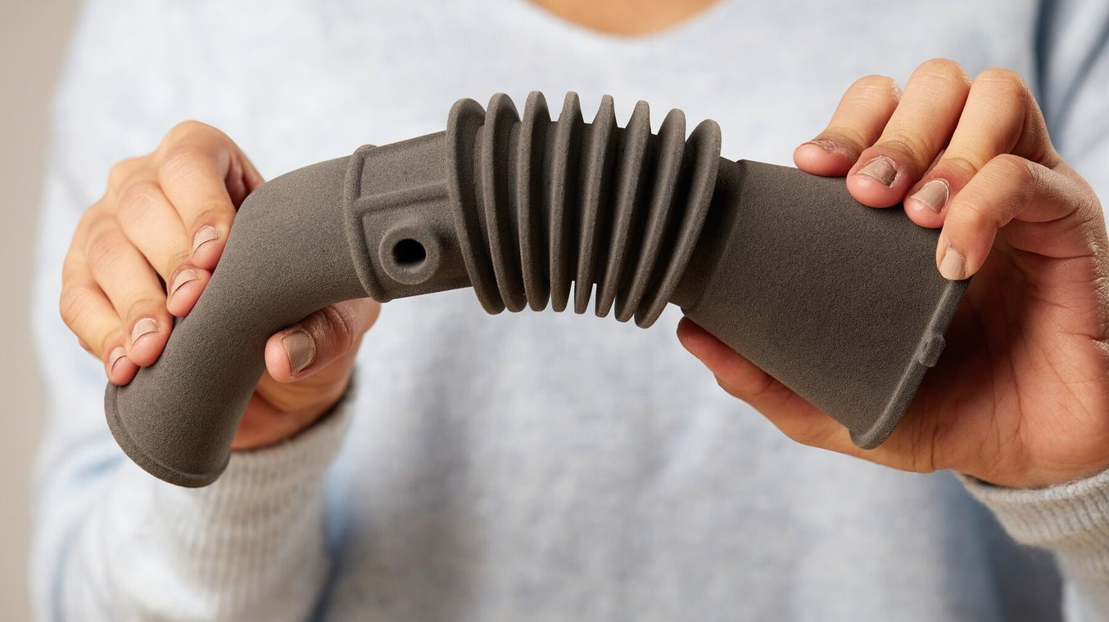
Materials
3D printers melt filament which consists of different materials.
PLA, PETG, TPU, ABS, ASA, Nylon, etc
Each material has pros and cons such as material properties, how difficult it is to print and how expensive the filament is.

Slide 6
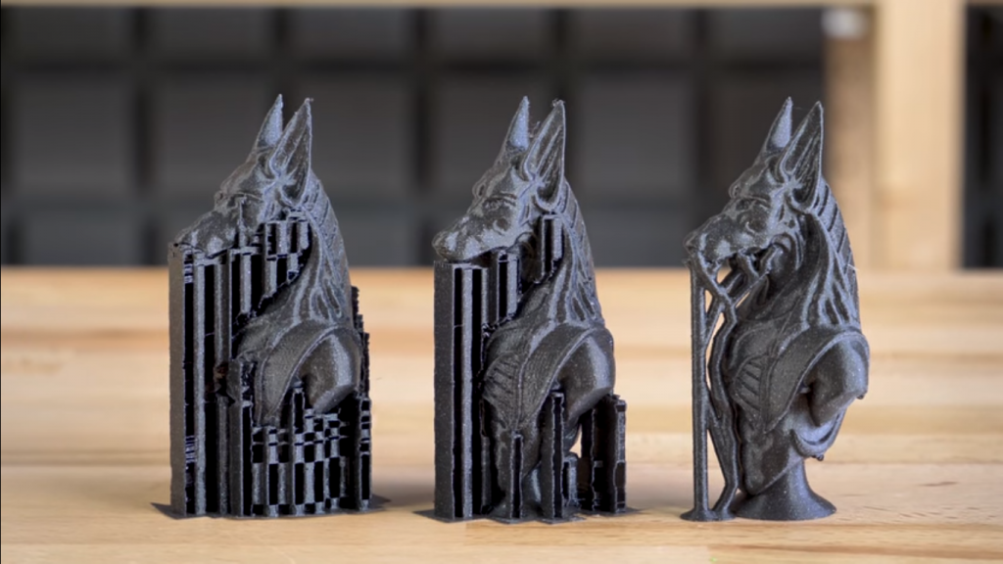
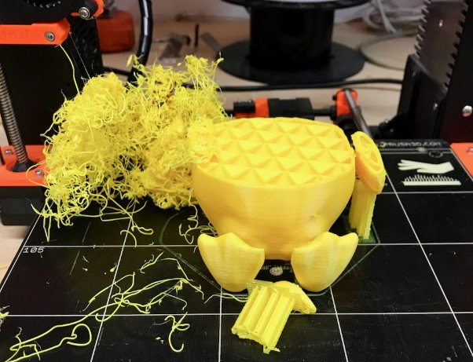
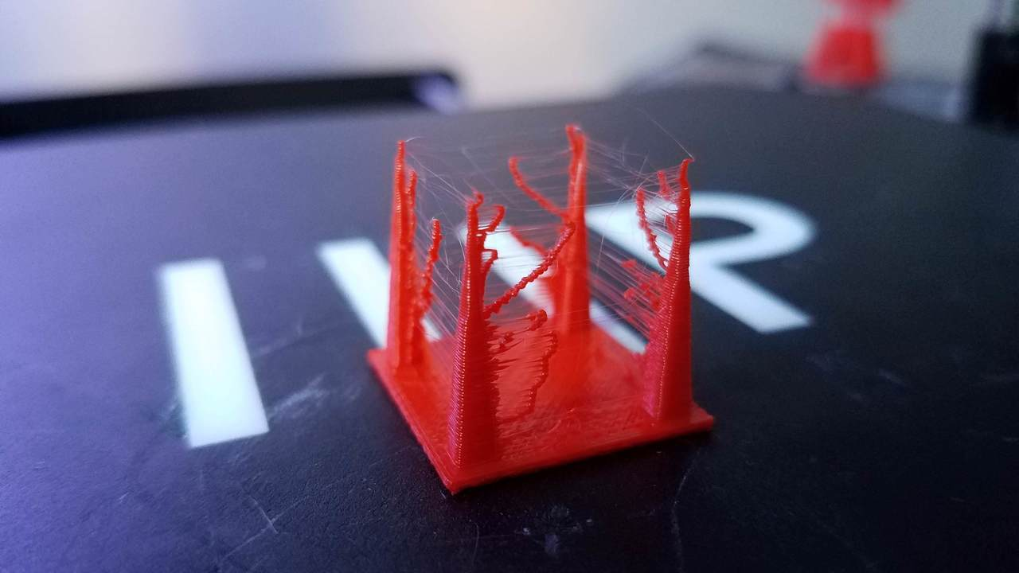
Limitations
Nozzle size determines resolution and print times. More print times equals more failure rate.
Supports are required for elements that hang which take more time and material
Not uncommon for prints to fail, 3D printing is very much like an art

